Slide 1

CMR COLLEGE OF ENGINEERING & TECHNOLOGY
Kandlakoya, Medchal, Hyderabad - 501401
Department of Computer Science and Engineering
WEBSITE BLOCKER
Batch No : 51
Name of the student:
20H51A0568-M.Priyanka
20H51A05K7-Nishith Reddy
20H51A05K8-Sai Karthik
Under esteemed guidance of
Guide Name: T.Adarana

Slide 2
Outline
Abstract
Introduction
Research Objective
Problem Definition
Scope of the Project
Research work
- Proposed Methodologies
- System Architecture
- Comparison of Proposed system with an existed system
Results
Conclusion
Future Work
References
Notes:
2

Slide 3
Abstract
Notes:
3

Slide 4
ABSTRACT
This project aims to develop a website blocker program which is used to block certain websites like Instagram, Facebook etc., which can distract the user during your work hours.
You can find a lot of helpful information on the Internet that could help you do your job better. It is, however, unfortunate that a rapid access to such an extensive quantity of content can also lead to disappointment.
So, this project can help you overcome the temptation of distraction and addictive technologies, instead of forcing you to rely on will-power alone, this will cut off access to your biggest distraction sources.

Slide 5
INTRODUCTION
Notes:
5

Slide 6
Introduction
Website Blocker is a tool that denies access to websites permanently or by schedule.
To use the internet safely we can block all websites from unwanted categories. website blocker is proven to keep out unwanted content and block websites with the best Internet filter available in the market today.
You can feel confident that our parental control software is secure and that you have the ability to tailor the range of settings to fit the diverse needs of each member of your family to keep them safe while they use their devices online.
Notes:
6

Slide 7
Research Objective
Notes:
7

Slide 8
Research objective
The main objective of a Python project website blocker is to develop a program that can restrict access to specified websites on a computer or a network. In today's digital age, the internet has become an indispensable part of our daily lives, and while it offers numerous benefits, it can also be a major source of distractions.
By blocking distracting websites and apps, you will be more focused and productive. You will develop healthier, more intentional digital habits, that give you control over your time and attention and there are certain times when we face the need to block different websites on our system
The website blocker program can be customized to block access to certain websites during specific times or intervals, making it an effective tool for increasing productivity, reducing distractions, or implementing parental controls.

Slide 9
Problem Definition
Notes:
9

Slide 10
Problem Definition
The main problem that this project aims to solve is the issue of excessive Internet use, particularly during work or study time. Many people struggle with procrastination and distraction while working on their computers, and one of the primary culprits is often the plethora of websites and social media platforms available at their fingertips. By blocking access to these sites, the website blocker can help users stay on task and avoid wasting time online.
The goal of the Python project website blocker is to create a tool that can be used to block access to certain websites on a user's computer. This tool is designed to help users increase their productivity and reduce distractions by preventing them from accessing time-wasting websites during work or study hours.

Slide 11
Scope of the Project
Notes:
11

Slide 12
Scope of the Project
The primary aim could be to help users increase productivity by blocking distracting websites during work or study hours.
The project focus on providing parents with tools to manage their children's internet access and protect them from inappropriate content.
It could center on improving online security by blocking malicious websites and protecting users from phishing attempts.
The project could target users looking to reduce internet addiction or manage their screen time effectively.

Slide 13
Research Work
Notes:
13

Slide 14


Proposed Methodologies
Our aim is to develop a project which can be able to block all kind of websites even the remote notifications and third party notifications
we ensure the system is effective, it will be regularly updated to include new websites and keywords that may need to be blocked.

Slide 15
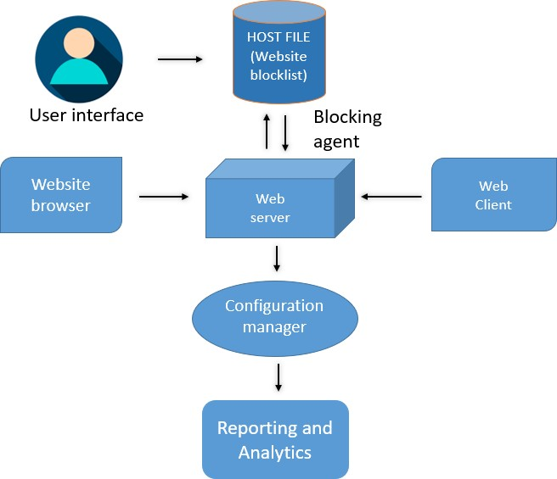
System Architecture

Slide 16
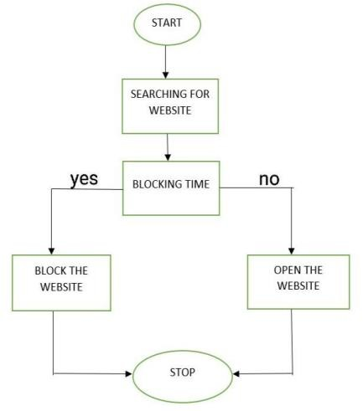

Slide 17
Comparison of Proposed system with an existed system
The existing system of website blockers is designed to restrict access to specific websites, either for individual users or across an entire network. These blockers operate by using either software or hardware-based solutions to filter or block web traffic to the targeted sites.
In the Existing System it is unable to block few third –party notifications. It fails to block the remote notifications.
Existing Projects: 1.Freedom App
2.Focus App

Slide 18
Result Analysis
Blocking Accuracy: Assess how accurately website blockers can identify and block unwanted content. This can include testing their ability to block specific categories of websites (e.g., adult content, social media, gaming).
False Positives/Negatives: Evaluate the rate of false positives (blocking legitimate content) and false negatives (allowing prohibited content) to determine the precision of the blocking mechanism.
Ease of Use: Analyze the user-friendliness of website blockers. Are they easy for non-technical users to install and configure?
Customization: Investigate the extent to which users can customize the blocking rules and settings to fit their specific needs.
Productivity Metrics: Collect data on how website blockers affect users' productivity at work or school. This might involve monitoring time spent on blocked sites compared to productive activities.

Slide 19
Conclusion
Website blocker can be expanded in many ways to provide more functionality and improve its usability. One potential future scope is to create a more intelligent blocking system that adapts to a user's behavior. Another potential future scope for the website blocker is to add a feature for time-based blocking. Currently, the blocker only allows for websites to be blocked and unblocked by the admin.The goal of website-blocking policies is to increase productivity and minimize the business's potential security and legal risks.Website blocker is the project which will block the given list of websites. The user cannot distract from their work. It will be helpful to the organization and the user

Slide 20
Future work
Develop advanced website blockers tailored for use in enterprise environments, with features like monitoring and reporting for managers and administrators. Allow users to customize the block pages that are displayed when they attempt to access blocked websites, potentially incorporating motivational messages or productivity tips.
Offer website blockers in multiple languages and adapt them to diverse cultural contexts to make them more accessible and effective worldwide.
Develop website blockers that can update their blocking rules from the cloud, ensuring that they remain effective against newly emerging websites and content.

Slide 21
References
1. http://inet.nttam.com/HMP/PAPER/132/abst.html.
2. http://www.w3.org/PICS/services-960323.html.
3. http://www.solidoak.com/cybersit.htm,
4. http://www.surfwatch.com.

Slide 22
Thank You!

